Slide 1
Description and Findings about Diabetes (The United States 2018)
Data Source: 2018 National Health Interview Survey

Slide 2
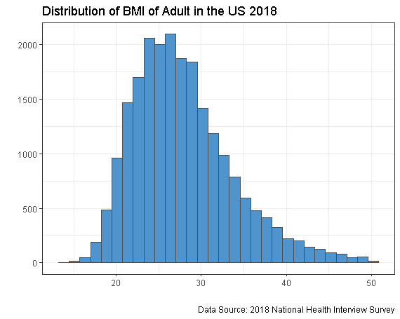

Slide 3
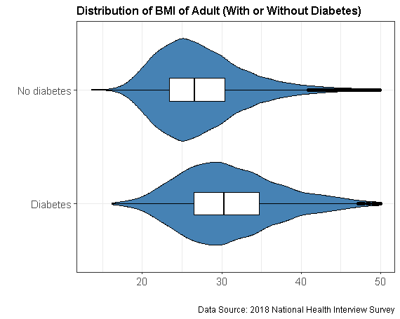

Slide 4
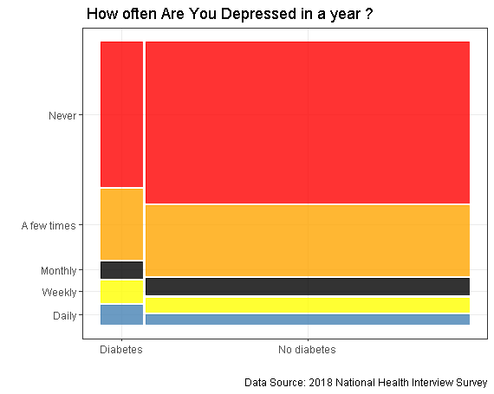

Slide 5
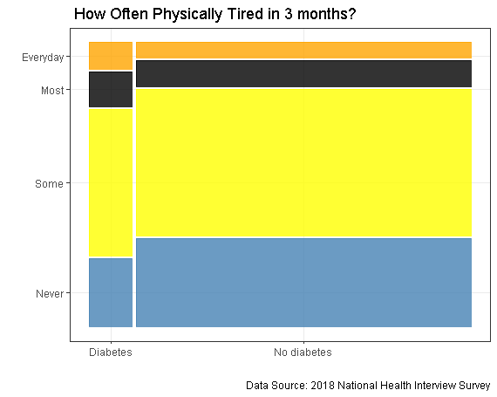

Slide 6
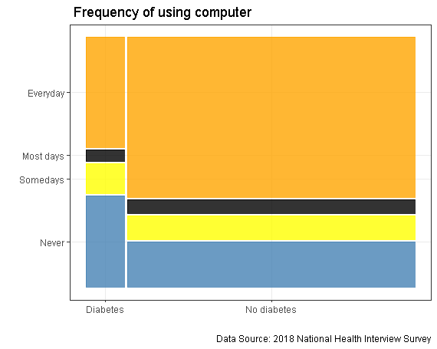

Slide 7
